Slide 1
To explore the character of Beowulf

Slide 2
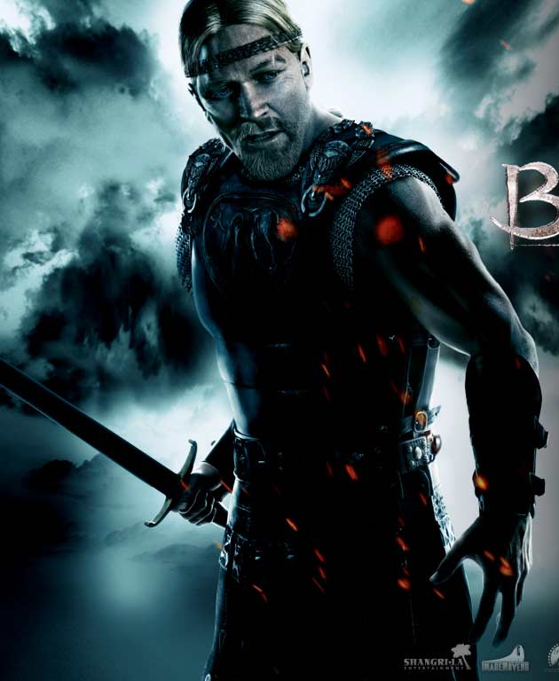
Brain storm…

Slide 3
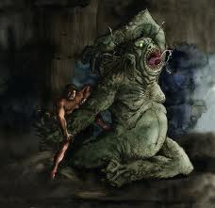
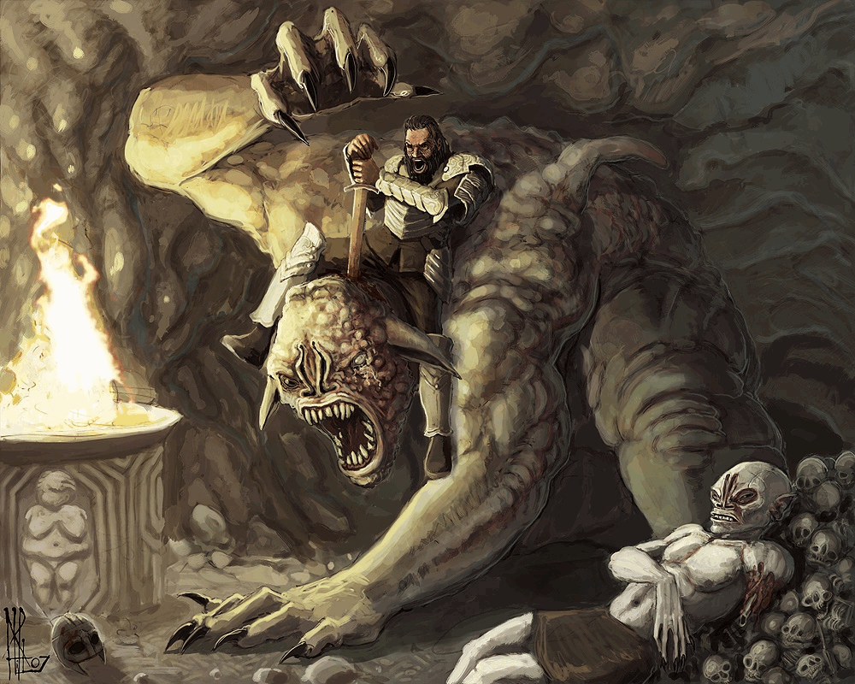
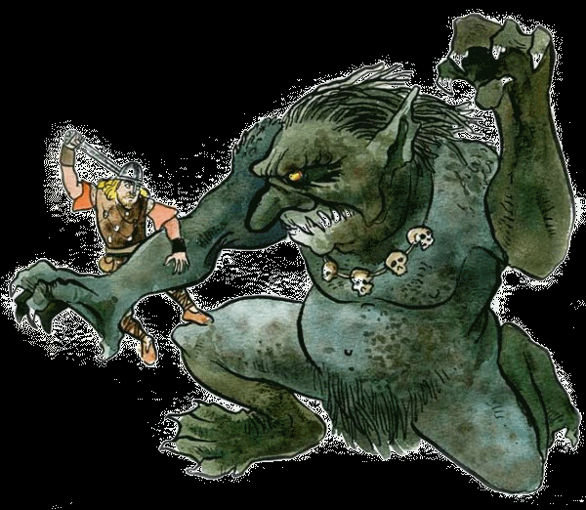
Grendel

Slide 4
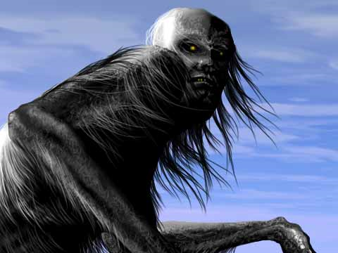
Grendel
The cruel creature, known to the fearful people of Heorot, only as Grendel. He was a flesh eating, blood thirsty monster who only advanced his attack at night.

Slide 5
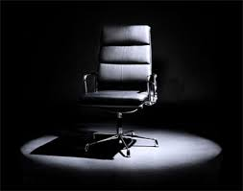
Hot seating
What questions can we ask to learn more about Beowulf?

Slide 6
Speaking frame
Beowulf’s appearance was…
He reminds me of…
He seems to be…
He was as…
In comparison to…
In my opinion…

Slide 7
Beowulf
Can you write your own description of Beowulf ?
Make sure you
Use descriptive language to describe the hero
Use figurative language to describe the hero
Write in the style of the Epic poem

